Slide 1

Notes:
Imagine you have just fallen, have extreme hip pain, and go to the local Emergency Dept
After you get some lovely pain meds, Xrays, etc, the orthopedic surgeon says he must operate to fix your broken hip
You end up with a total hip replacement and are admitted for a few days where people come in and out of your room constantly giving you instructions and medication.
Physical therapists get you up, and teach you how to walk with a walker, which you’ve never used.
The occupational therapists teach you how to put on your shoes and socks with equipment you’ve never seen.
Since it’s difficult and painful, and you can’t walk more than a few feet at a time, they are recommending subacute rehab.
This will allow you to continue to recover with regular therapy and nursing attention.
They can progress your program so that you can get home safely and with less pain.

Slide 2
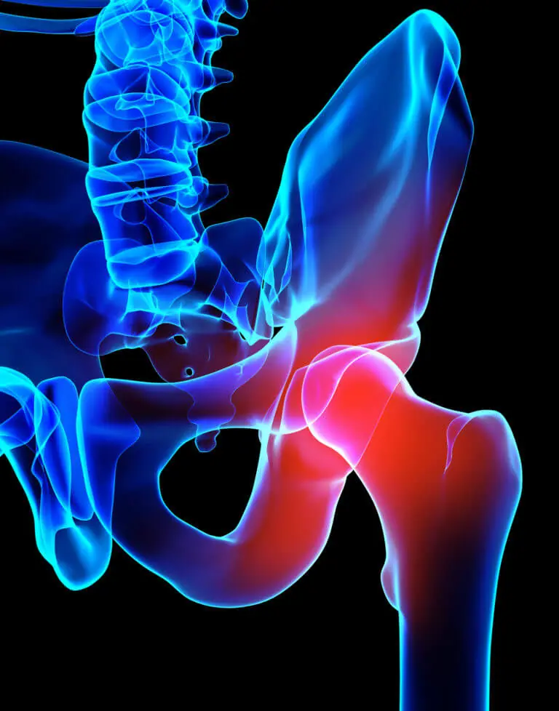
Problem
Patients uninsured or under-insured
Don’t qualify for post-acute services
Discharge home from hospital with few resources
Overwhelmed by information and instructions
Notes:
But you don’t have insurance, or your insurance doesn’t cover rehab.
Or you were just in a rehab facility and have used up all of your rehab days and would have to pay hundreds of dollars to return, but you’re on a fixed income.
All of these scenarios happen daily at your local hospital.
Now you have to go home with a hip that was just fixed a few days ago. You can’t walk far. You have 12 stairs to get to your bedroom at home.
You’re given instruction on which meds to take, where to go for your next appt
The hospital has arranged non-emergent transport to your home.
You get home and try to remember everything you were told at the hospital
Your leg is hurting, but what are you supposed to do again? You’ve been taking pain medication and can’t remember it all
How long am I supposed to use ice? Is it time for my next medication?
I’m ready to go to bed but which leg goes up the steps first? Can I shower?
What were those exercises I’m supposed to do??
And the therapists kept telling me not to rotate my leg – was that in or out?
Your spouse has to get back to work tomorrow, so you will be alone to remember everything. You have a stack of papers and instructions… where do you start?

Slide 3
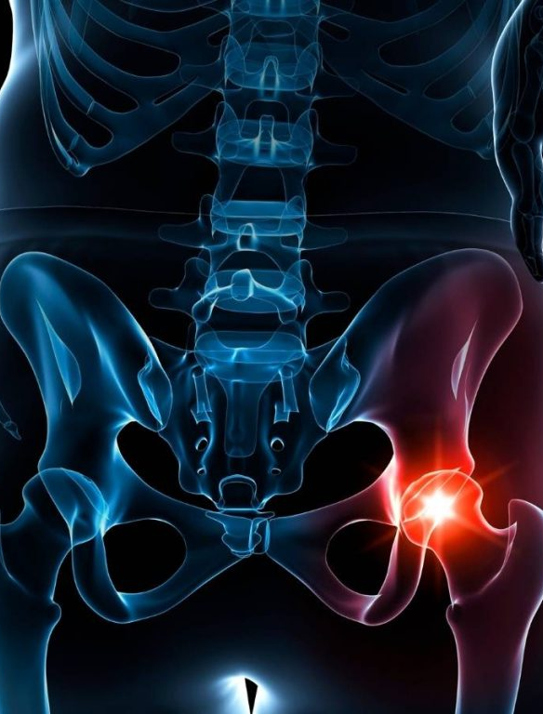
PostOp Pal
LOW COST SOLUTION
GUIDE AND PROGRESS THROUGH PHASES OF RECOVERY
Home exercise program
Post-op care instructions
Safety precautions
Reminder prompts
Helpful tips/tricks
JUDITH SOUTHARD, PT, DPT
Notes:
Then you remember that your physical therapist gave you a program that you can use to help you and your caregiver – PostOp Pal
It’s one simple, easy, customized solution
A program that will guide you through your post-operative phases of rehab
An individualized home program specific to your surgery that can progress your exercises.
Post-op care instructions for pain management like positioning ideas or modalities
The do’s and don’ts on which way you cannot move your leg after surgery
Reminder prompts to complete your exercise program, change position, and
Other helpful tips and tricks to maximize your recovery
All of this in one easy program.

Slide 4
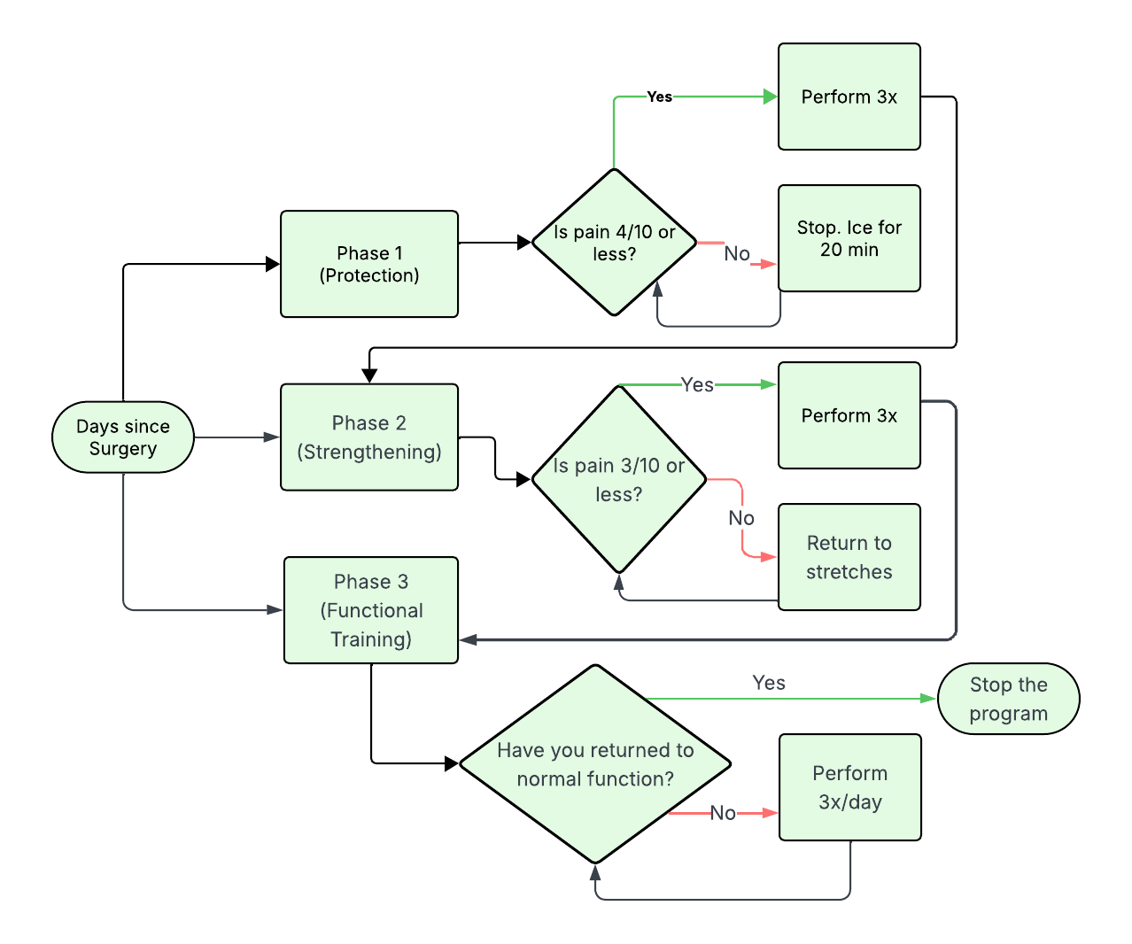
PostOp Pal
Flow Diagram
Notes:
Here is an oversimplified sketch of PostOp Pal in action
You select your phase by entering the date of your surgery.
The program will direct you to the appropriate phase of recovery.
Prompting questions will appear to ensure you are meeting criteria to complete program that day, or progress further, depending on your post op stage.
If you meet criteria, you will be able to start the program. If not, it will tell you to try something else such as stretching until you can meet criteria.
Once you have met all criteria, you would progress to the next phase, assuming you are in the correct post-op days.
Once you have returned to normal function, the program will stop.

Slide 5
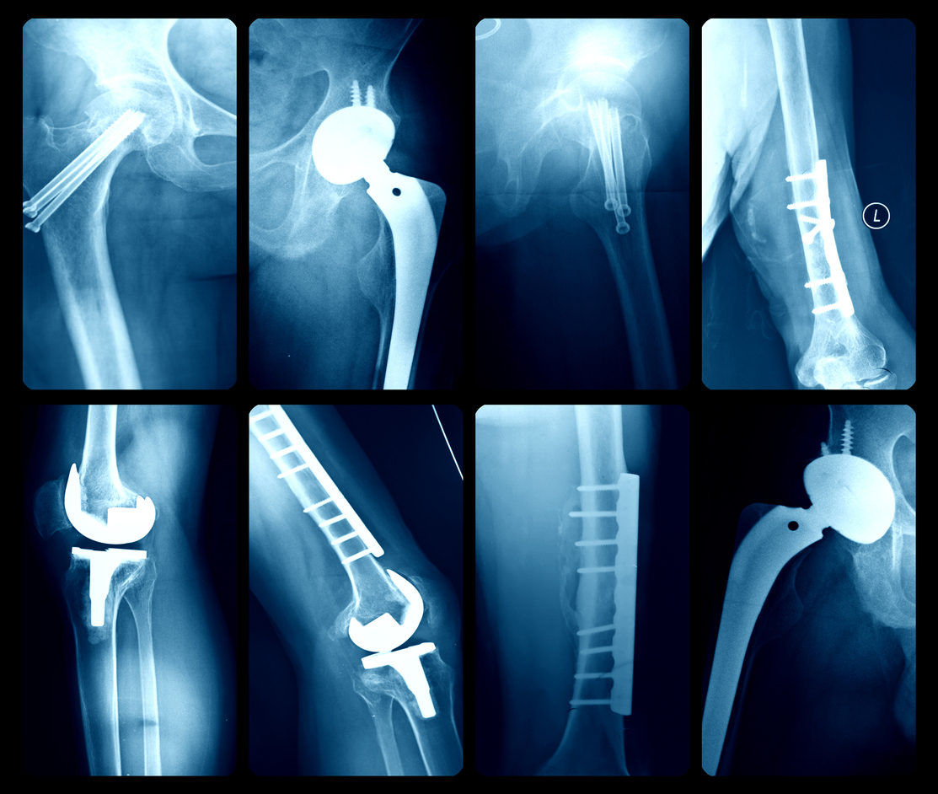
Thank you
Notes:
Now I turn to you – the board of directors
Will you continue to send patients home without the proper tools? When we do this, we aren’t sending them home to recover, we are leaving them to struggle
Those patients are at a high risk of readmission.
PostOp Pal isn’t just an expense or a budget line item approval.
You will directly prevent complications for our most vulnerable patients who could be your neighbor.
Let’s make sure everyone you care about has the support they need.
Thank you. Any questions?
*For development, design, operating cost, and ongoing maintenance, $125,000.

